Slide 1
E-Commerce Customer Segmentation and Prediction.

Slide 2
Agenda
1. Understanding Customer Behavior
2. Customer Segmentation Techniques
3. Predictive Modeling for Customer Behavior

Slide 3
Sector -1
Understanding Customer Behavior

Slide 4
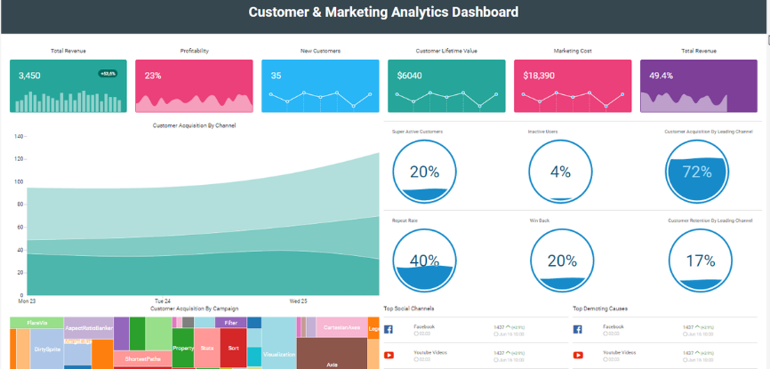
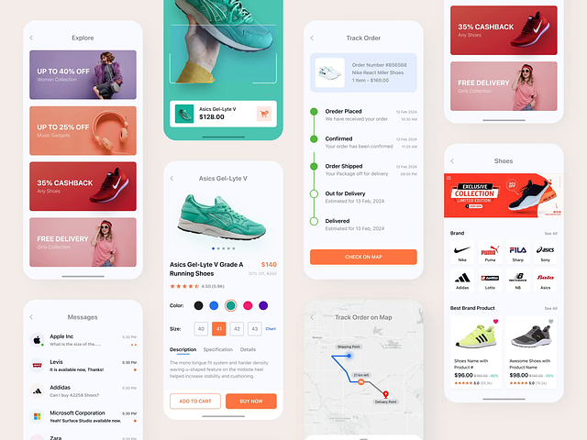
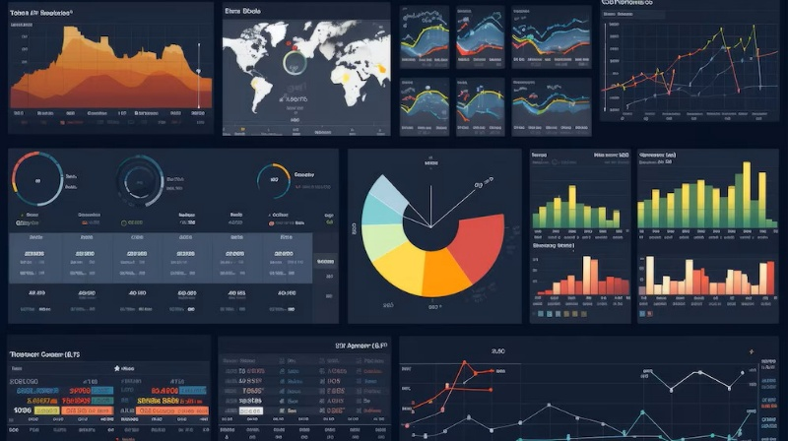
Overview of E-Commerce Customer Data
Data Collection Methods
E-commerce platforms utilize various data collection maethods, including web analytics, customer surveys, and transaction records, to gather comprehensive insights on customer behavior and preferences.
Types of Customer Data
Key types of customer data include demographic information, purchase history, browsing behavior, and engagement metrics, which are essential for effective segmentation and targeted marketing strategies.
Importance of Data Quality
High-quality customer data is crucial for accurate analysis and segmentation; ensuring data accuracy, consistency, and completeness enhances predictive modeling and decision-making processes in e-commerce.

Slide 5
Key Metrics for Customer Segmentation
01
Customer Lifetime Value (CLV)
CLV measures the total revenue a business can expect from a single customer account throughout their relationship, guiding segmentation strategies to focus on high-value customers.
02
Recency, Frequency, Monetary (RFM)
RFM analysis evaluates customers based on their purchase recency, frequency of purchases, and monetary value spent, providing insights into customer loyalty and engagement levels.
03
Churn Rate
c

Slide 6
Importance of Customer Retention and Personalization
01
Enhancing Customer Loyalty
Retaining customers is more cost-effective than acquiring new ones; personalized experiences foster loyalty, encouraging repeat purchases and long-term relationships with the brand.
02
Increased Revenue Potential
Personalized marketing strategies can significantly boost sales; tailored recommendations and offers based on customer preferences lead to higher conversion rates and average order values.
03
Competitive Advantage
Businesses that prioritize customer retention and personalization differentiate themselves in a crowded market; leveraging data-driven insights allows for targeted engagement, improving customer satisfaction and brand reputation.

Slide 7
Data Preprocessing Techniques
Data Cleaning
Removing duplicates, correcting errors, and handling missing values are essential steps in data cleaning, ensuring the dataset's integrity and reliability for subsequent analysis and modeling.
Feature Scaling
Normalizing or standardizing features helps to bring all variables to a similar scale, which is crucial for algorithms sensitive to the magnitude of data, such as K-Means clustering and gradient descent methods.
Encoding Categorical Variables
Transforming categorical data into numerical formats using techniques like one-hot encoding or label encoding allows machine learning algorithms to effectively interpret and utilize this information in predictive modeling.

Slide 8
Section 2
Customer Segmentation Techniques

Slide 9

Introduction to Clustering Models
Understanding Clustering
Clustering models are unsupervised learning techniques that group similar data points together based on their features, enabling businesses to identify distinct customer segments for targeted marketing and personalized experiences.

Slide 10

Implementation of K-Means Clustering
Algorithm Overview
K-Means clustering is an iterative algorithm that partitions a dataset into K distinct clusters by minimizing the variance within each cluster, making it a powerful tool for segmenting e-commerce customers based on purchasing behavior and preferences.

Slide 11
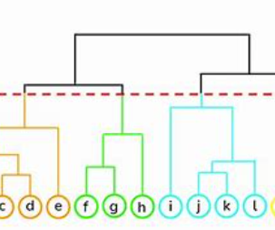
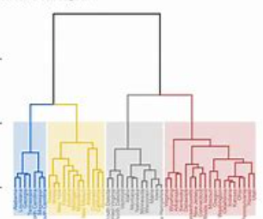
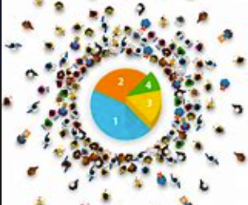
Hierarchical Clustering and Its Applications
Applications in E-Commerce
Hierarchical clustering can be applied to segment customers based on purchasing behavior, preferences, and demographics, enabling targeted marketing strategies and personalized recommendations to enhance customer engagement.
Dendrogram Visualization
The dendrogram is a tree-like diagram that illustrates the arrangement of clusters, providing insights into the relationships between different customer segments and aiding in the selection of an appropriate number of clusters.
Definition and Process
Hierarchical clustering is a method that builds a hierarchy of clusters either through agglomerative (bottom-up) or divisive (top-down) approaches, allowing for a detailed exploration of customer segments in e-commerce.

Slide 12
Evaluating Clustering Performance
Silhouette Score Analysis
The silhouette score measures how similar an object is to its own cluster compared to other clusters, providing a clear metric for evaluating clustering quality. A higher silhouette score indicates better-defined clusters, essential for effective customer segmentation in e-commerce.
Elbow Method for Optimal Clusters
The elbow method involves plotting the explained variance against the number of clusters to identify the optimal number of clusters. This technique helps in determining the point where adding more clusters yields diminishing returns, ensuring efficient segmentation strategies.

Slide 13
Section 3
Predictive Modeling for Customer Behavior

Slide 14

Overview of Predictive Classifiers
Definition and Purpose
Predictive classifiers are algorithms used in machine learning to categorize data points into predefined classes based on input features, enabling businesses to forecast customer behavior and tailor marketing strategies effectively.

Slide 15
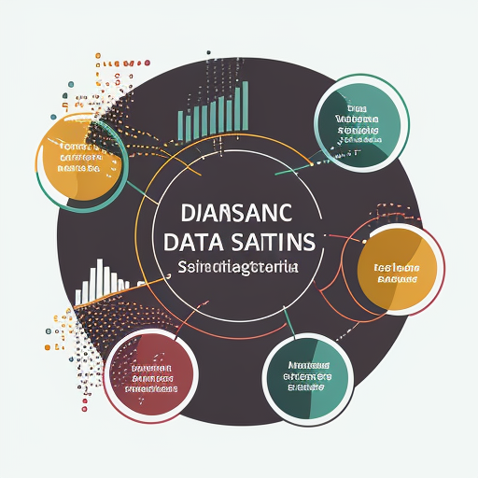
Performance Comparison of Logistic Regression, Random Forest, and XGBoost
Logistic Regression typically offers a baseline for classification tasks, while Random Forest and XGBoost often outperform it in terms of accuracy and precision due to their ensemble learning techniques, which reduce overfitting and improve generalization on unseen data.
While Logistic Regression is computationally efficient and easy to interpret, Random Forest and XGBoost require more resources; however, XGBoost is optimized for speed and performance, making it suitable for large datasets commonly found in e-commerce applications.

Slide 16
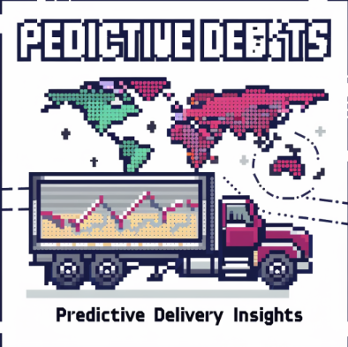
Business Implications of Predictive Insights
Strategic Decision-Making
Leveraging predictive insights allows e-commerce businesses to make informed strategic decisions, optimizing inventory management, marketing campaigns, and customer engagement efforts based on anticipated customer behaviors and preferences

Slide 17
Questions ?

Slide 18
Thank You!

